Slide 1
Performance Evaluation of Image Inpainting Algorithms Proposed in Pluralistic Image Completion Paper
By Yunting Chiu and Huong Doan
CSC-676 Computer Vision / Spring 2021 / American University

Slide 2
Outline
Introduction
Related Works
Methodology
Approach
Experiments
Results - SSIM Score
Results - PSNR Score
Result Comparison
Conclusion & Discussion
Future Works

Slide 3
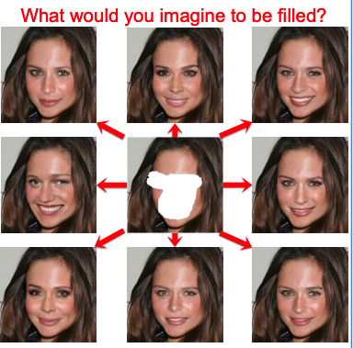
Source: Pluralistic Image Completion

Slide 4
Introduction
Only one optimal result is typically produced in existing image inpainting
Many methods overly focus on reconstructing the original image
PICNet introduces random noises for generating diverse results with a deep generative network [1].
Goal: Multiple and Diverse Plausible Results (50 Outputs)

Slide 5
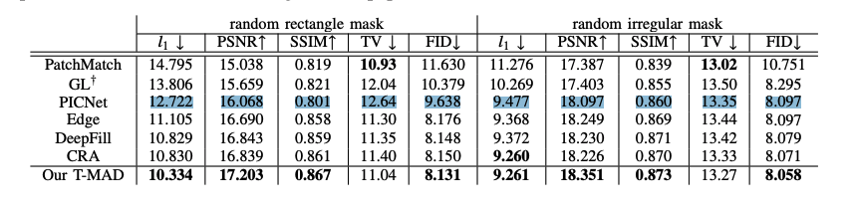
Related Works - T-MAD Model
Texture Memory-Augmented Deep Patch-Based Image Inpainting [1] is the latest paper (2020) about image inpainting.
This paper proposed a T-MAD model which is not only for image inpainting but also for object removal and high-resolution results.
The method PICNet is also compared with the T-MAD method and other inpainting methods.
Source: Texture Memory-AugmentedDeep Patch-Based Image Inpainting

Slide 6
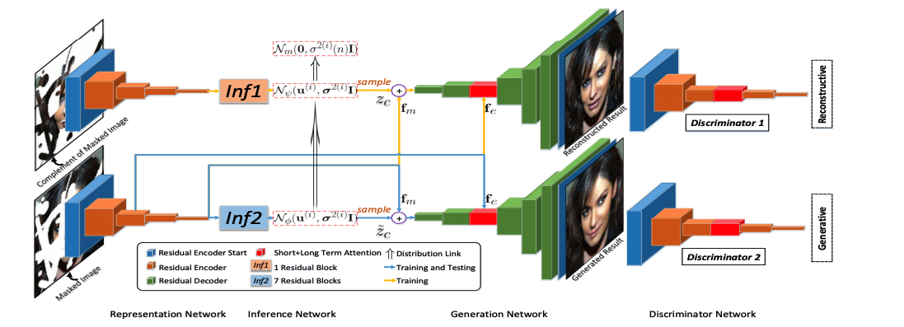
Methodology
Source: Pluralistic Image Completion
Ig is the original image, and Im is the masked image. The method is mapping Ig to Im
Define Ic as the converse of Im, which is constructed from the masked image
This paper final goal is to take sample from p(Ic|Im) to recover images

Slide 7
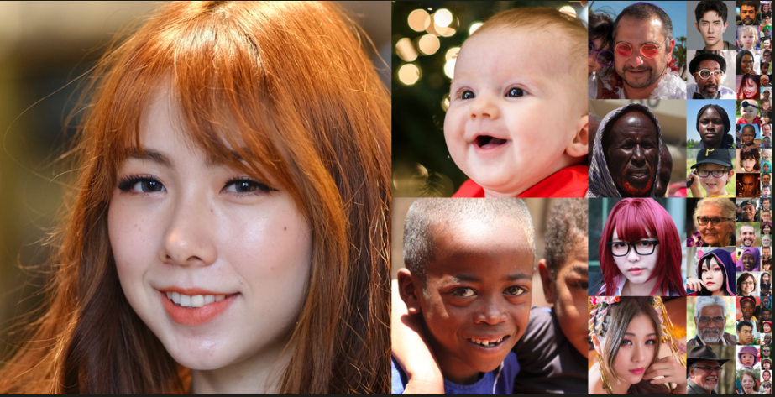
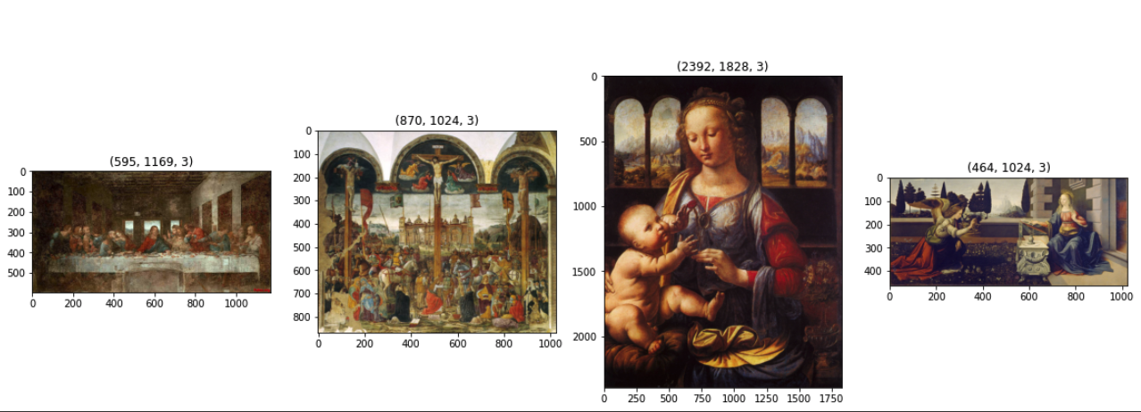
Approach - Datasets
FFHQ-Thumbnail dataset:
Training: 65536 images
Testing: 26 images (25+1)
Art work dataset:
Training: 8 images
Testing: 8 images
PC: NVIDIA Research Projects & Best Artworks of All Time in Kaggle

Slide 8
Approach - Strength
The authors did not use Art images to train and test PICNet
PICNet excels at inpainting people's faces.
Outputs are natural, realistic-looking
One image can generate 50 diverse images with plausible content

Slide 9
Approach - Limitation
Before running, the code must be modified
self.img = self.img.cuda(self.gpu_ids[0], async=True)
change from async=True to non_blocking=True
Colab Pro is crashed after 12 hours of running time
The maximum epoch is 41 (epoch is the number of passes of the entire training dataset)
Training images: FFHQ (65536) > Celeba (24183)
Running training model takes a long time
Smaller image sizes are preferred

Slide 10
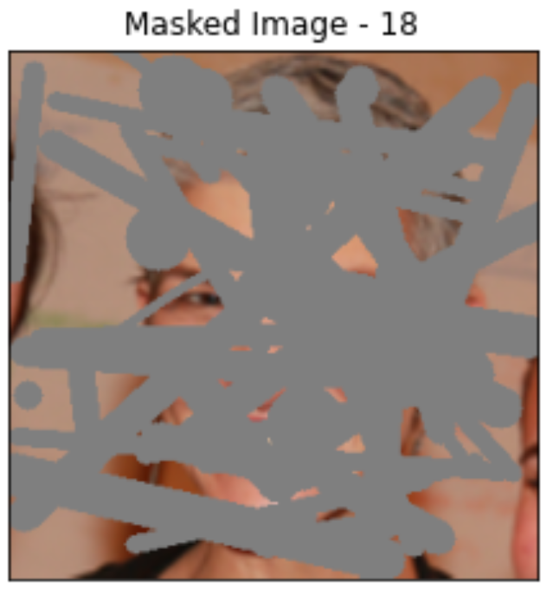
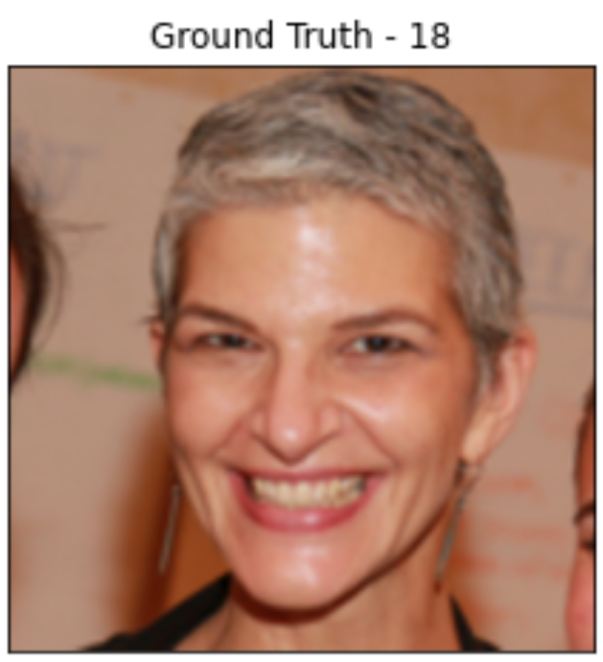
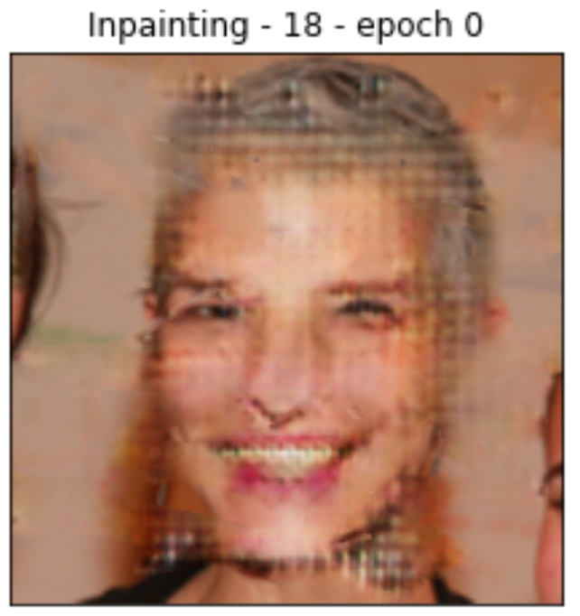
Experiments - Overview
PICNet model
Training ground truth images
Masked images
PICNet model
Testing ground truth images
Ground truth images
Evaluation metrics:
SSIM
PSNR
Inpainting images
Notes:
PSNR is most commonly used to measure the quality of reconstruction of lossy compression codecs.
https://en.wikipedia.org/wiki/Peak_signal-to-noise_ratio

Slide 11
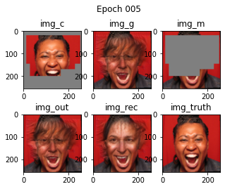
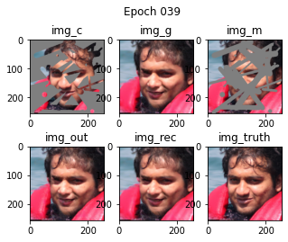
Approach- FFHQ Training Process

Slide 12
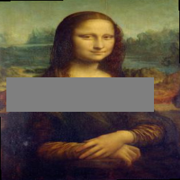
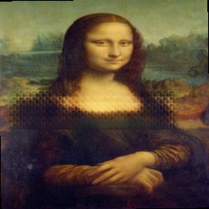
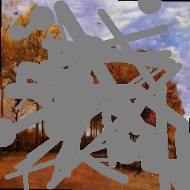
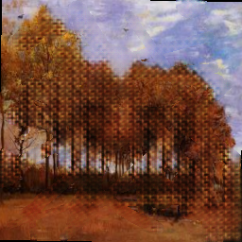
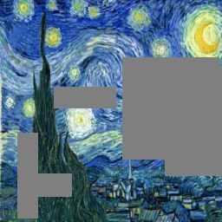
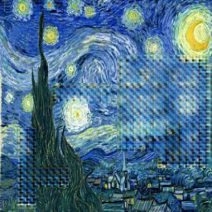
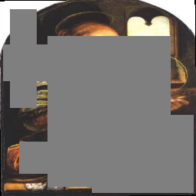
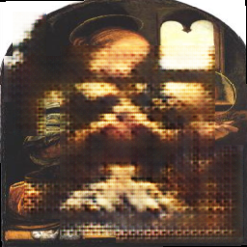
Approach - Art Work Training Process

Slide 13
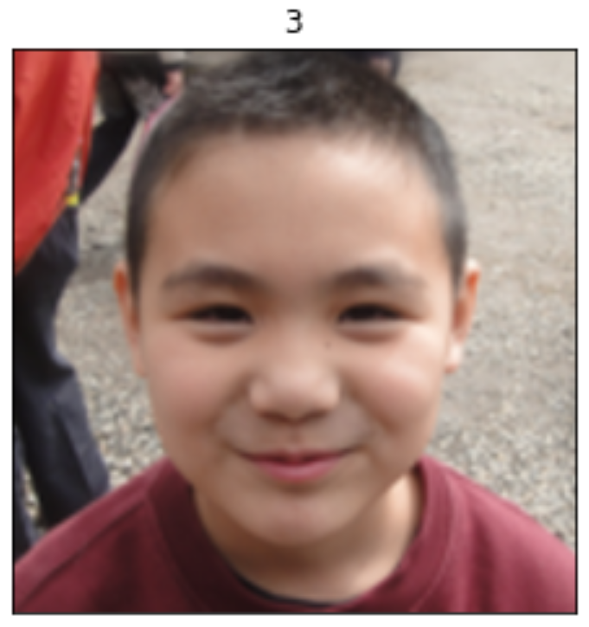
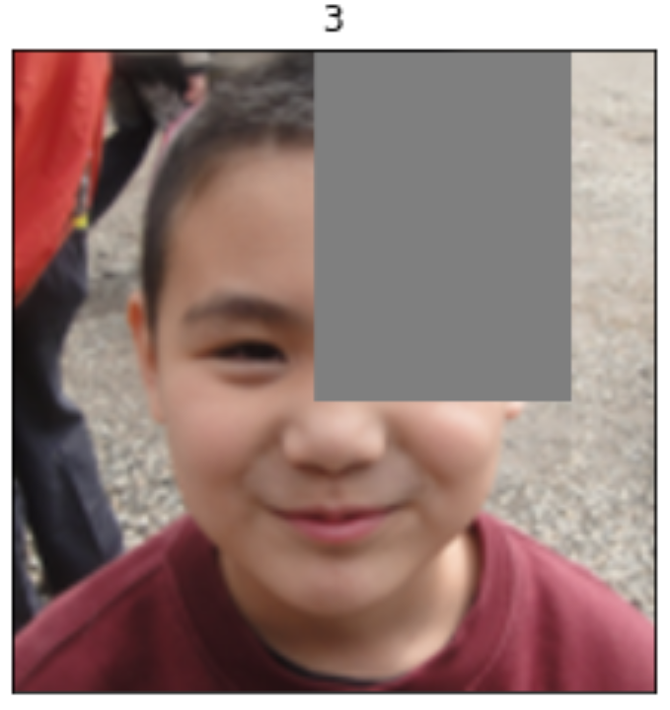
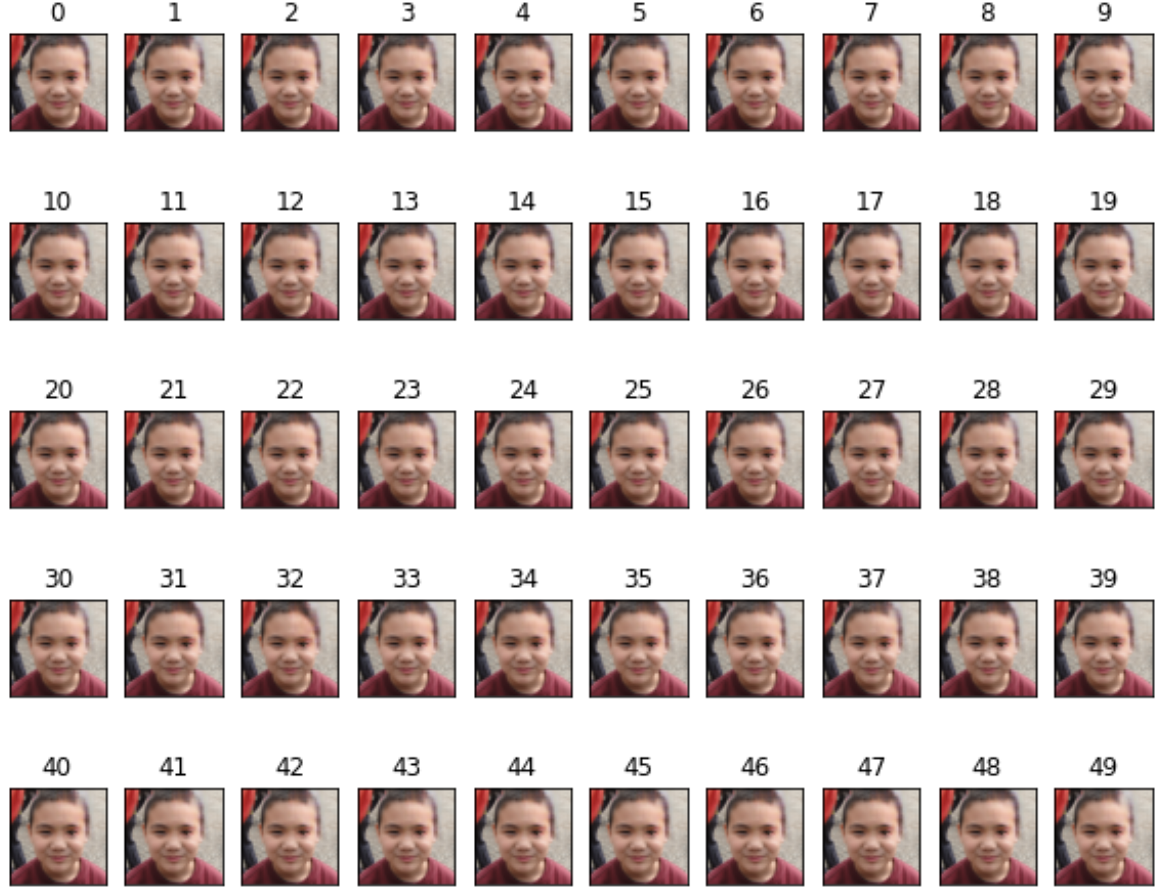
Approach - FFHQ Testing Process
26 ground truth images are used as input.
Each ground truth input image produces 50 diverse inpainting results with plausible content.
PICNet model
input
output

Slide 14
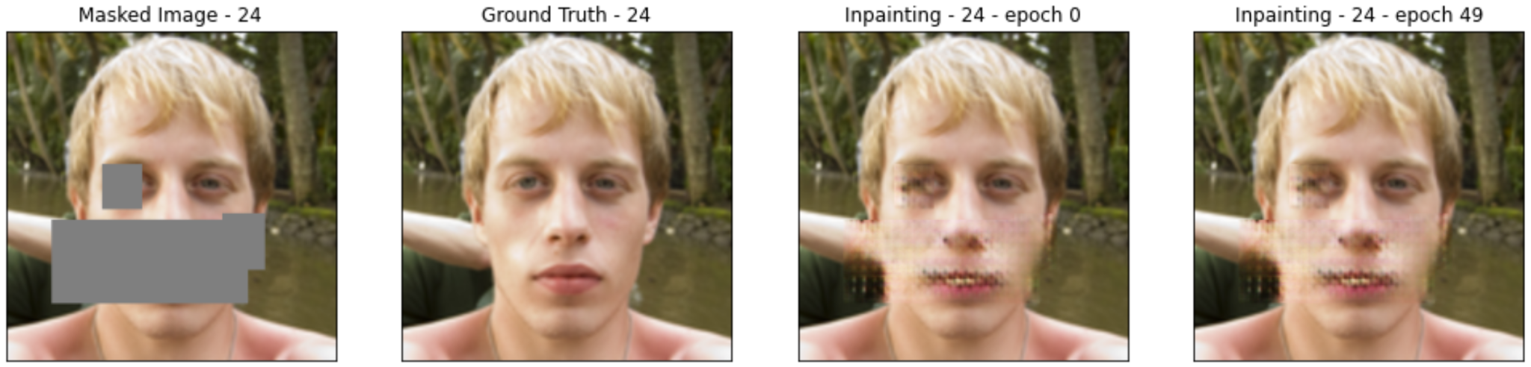
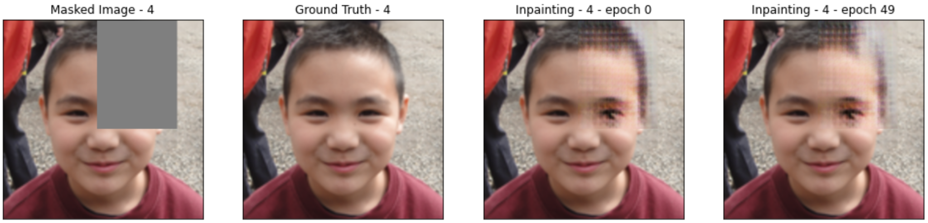
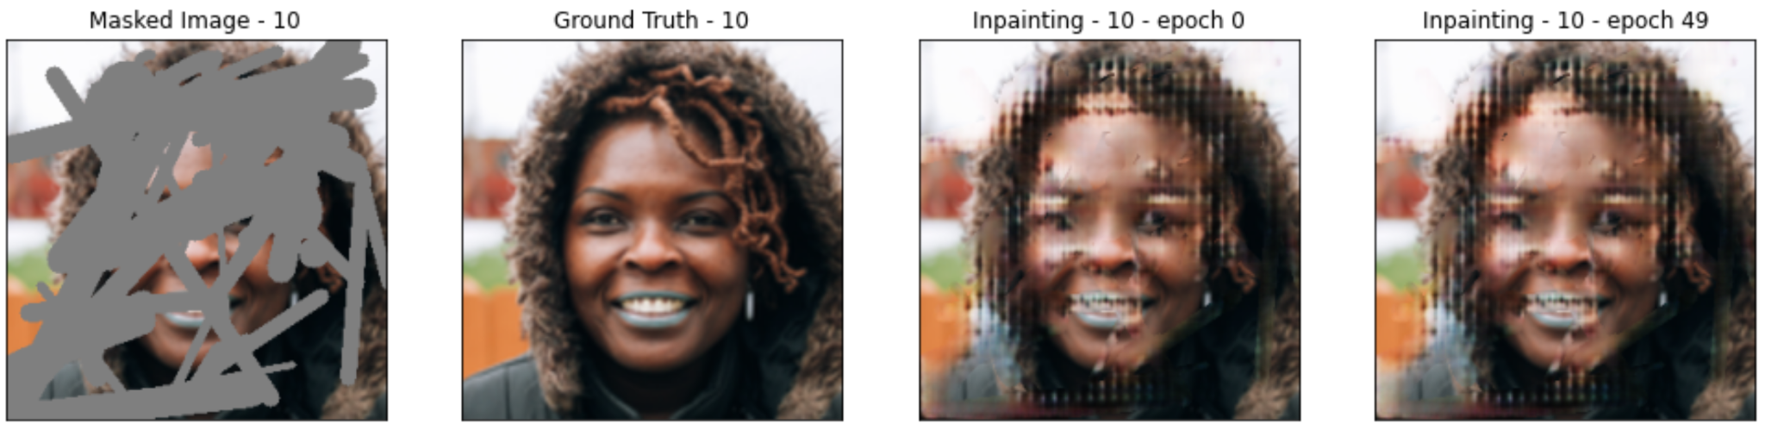
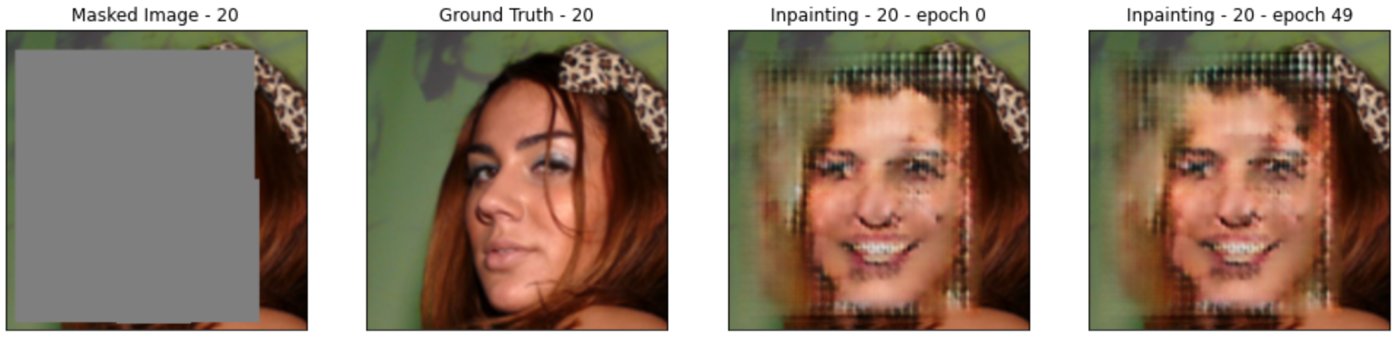
Results - Overview
Best SSIM and PSNR scores
Worst SSIM and PSNR scores

Slide 15
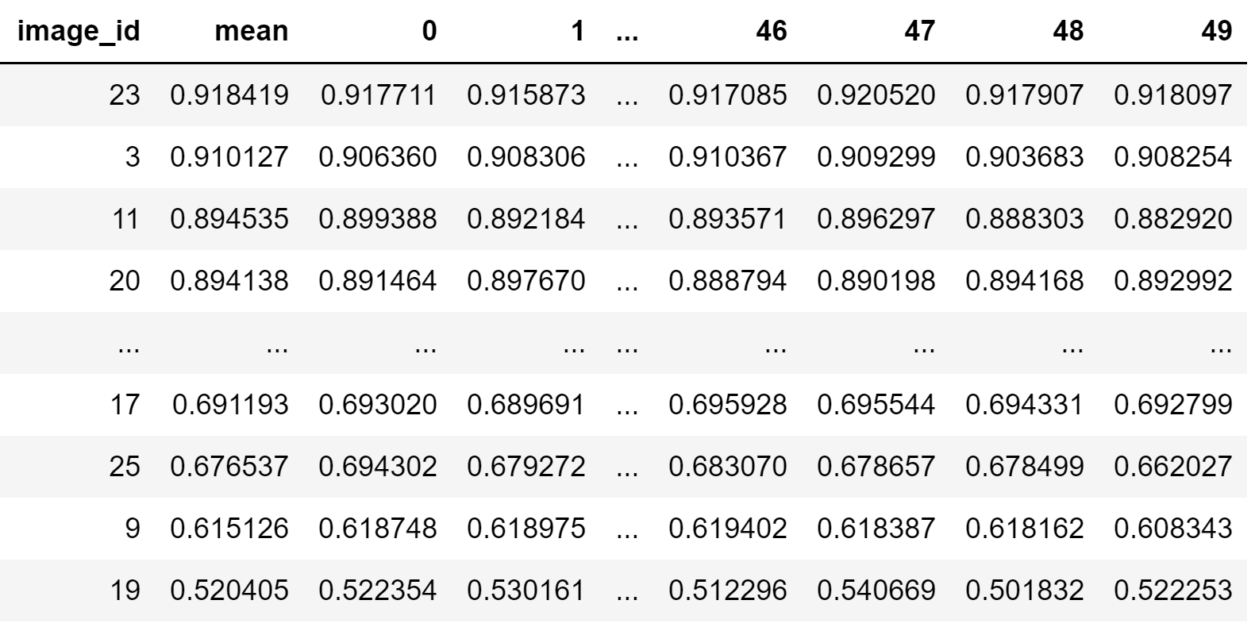
Results - SSIM Score

Slide 16
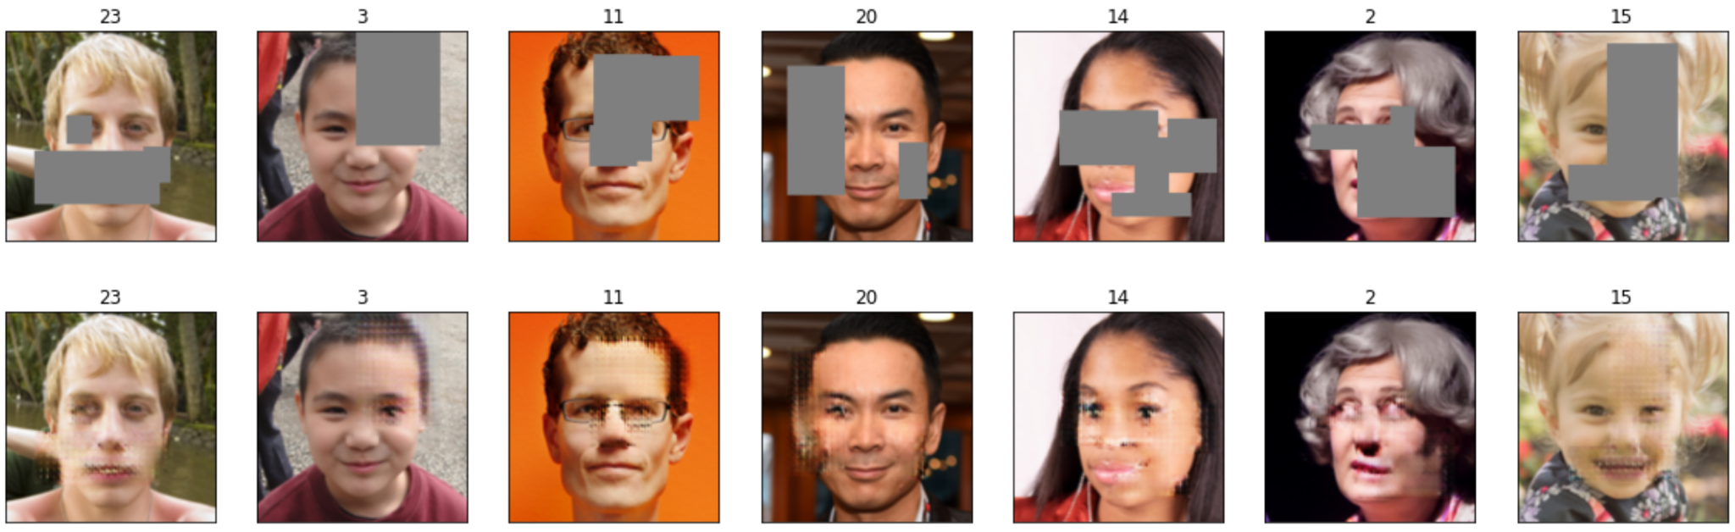
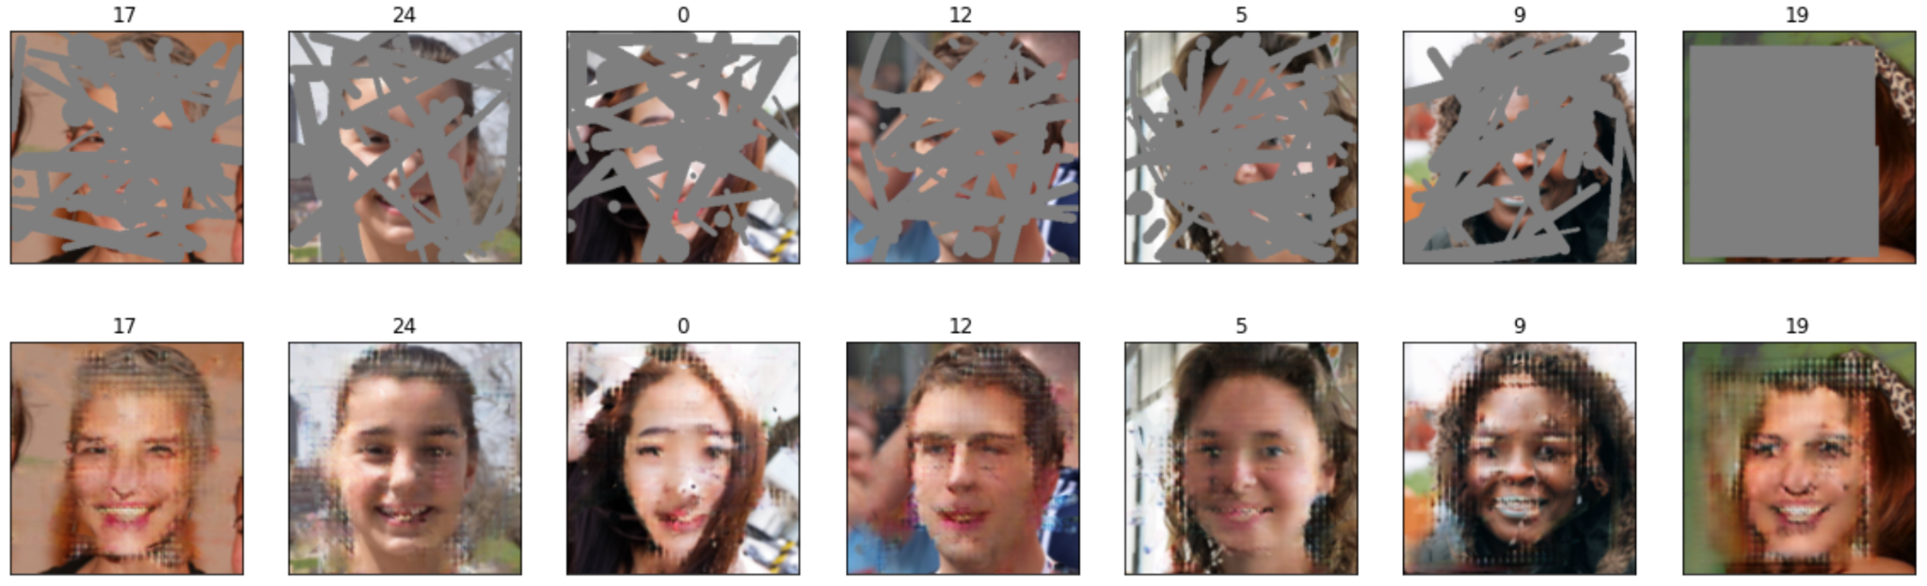
Results - SSIM Score
Masked Image
Best SSIM scores
Inpainting image
Masked Image
Worst SSIM scores
Inpainting image

Slide 17
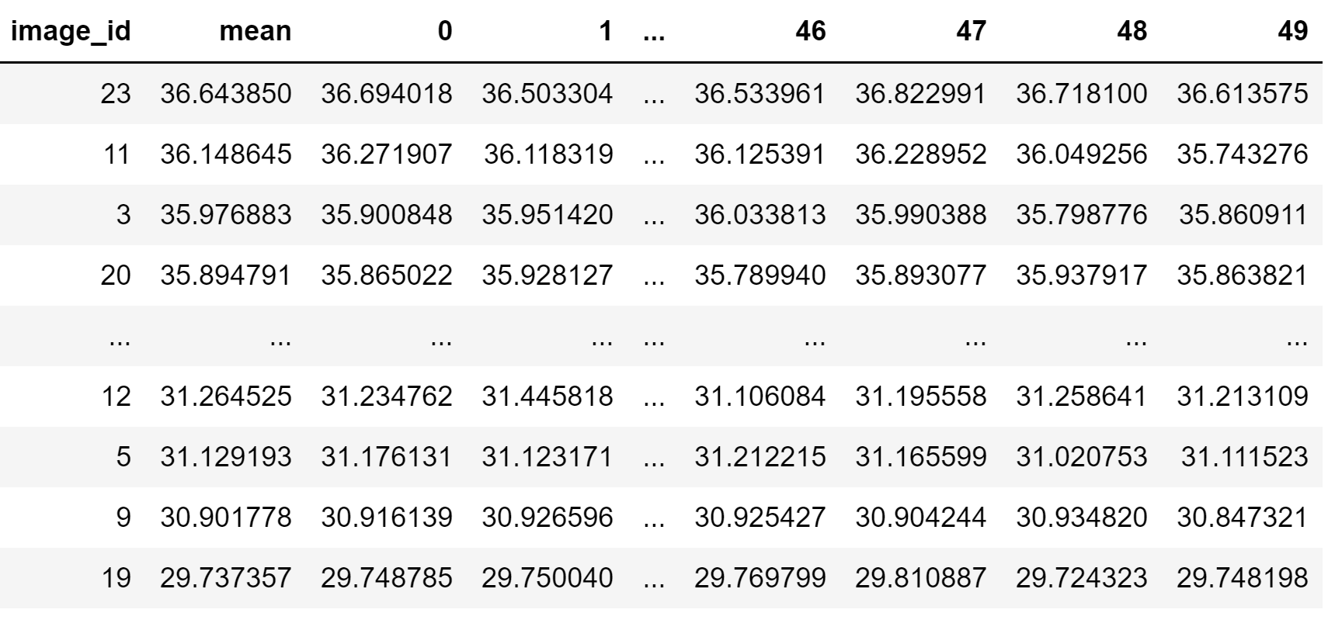
Results - PSNR Score
Notes:
PSNR is most commonly used to measure the quality of reconstruction of lossy compression codecs.
https://en.wikipedia.org/wiki/Peak_signal-to-noise_ratio

Slide 18
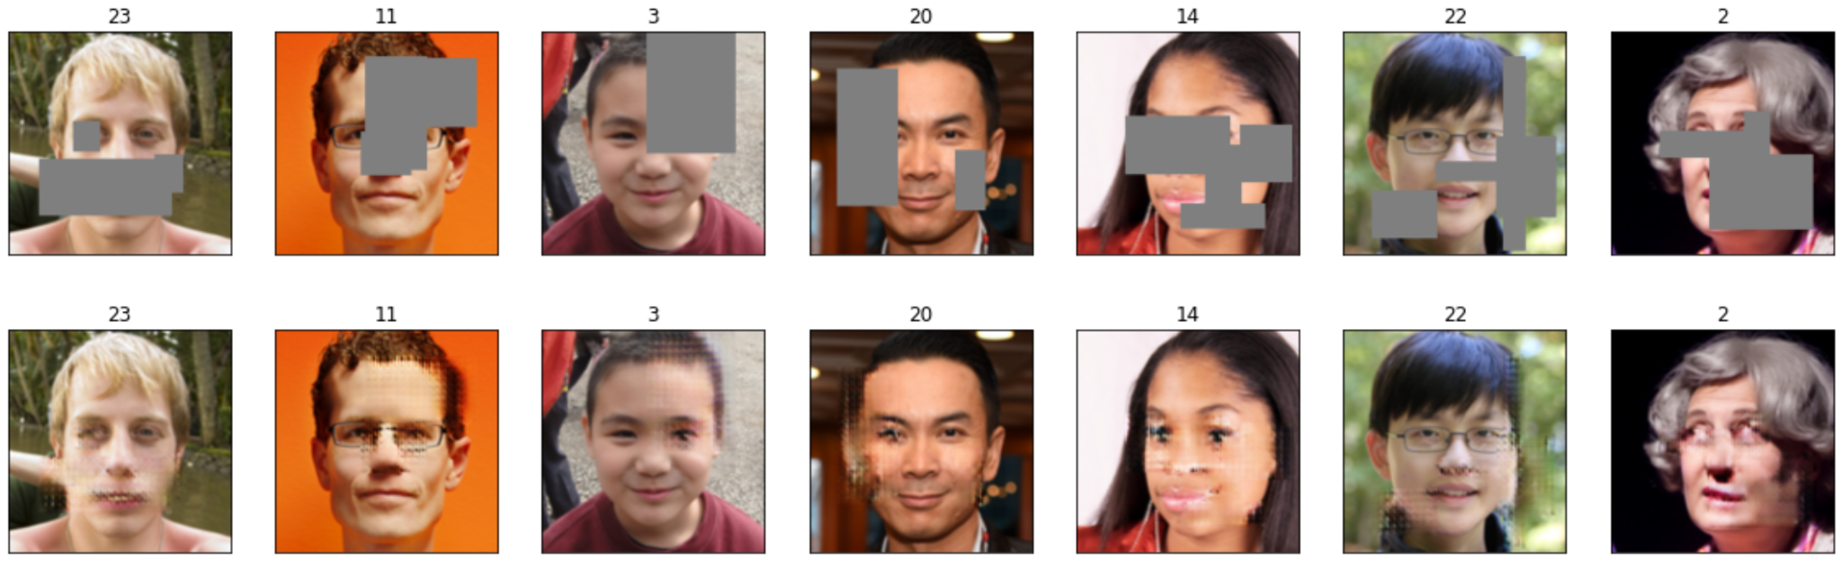
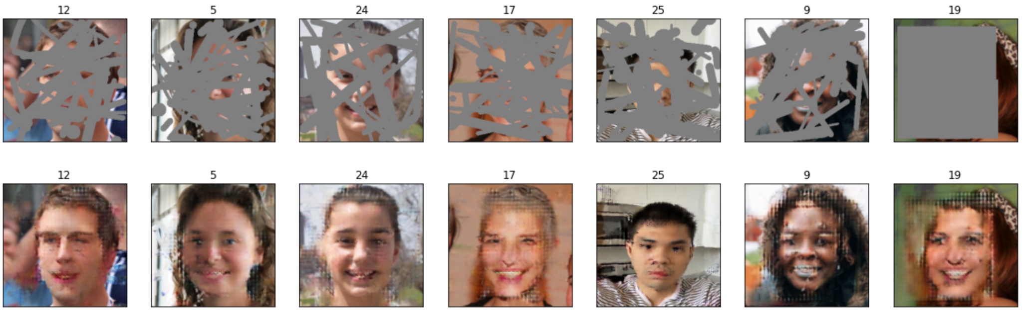
Results - PSNR Score
Masked Image
Best PSNR scores
Inpainting image
Masked Image
Worst PSNR scores
Inpainting image

Slide 19
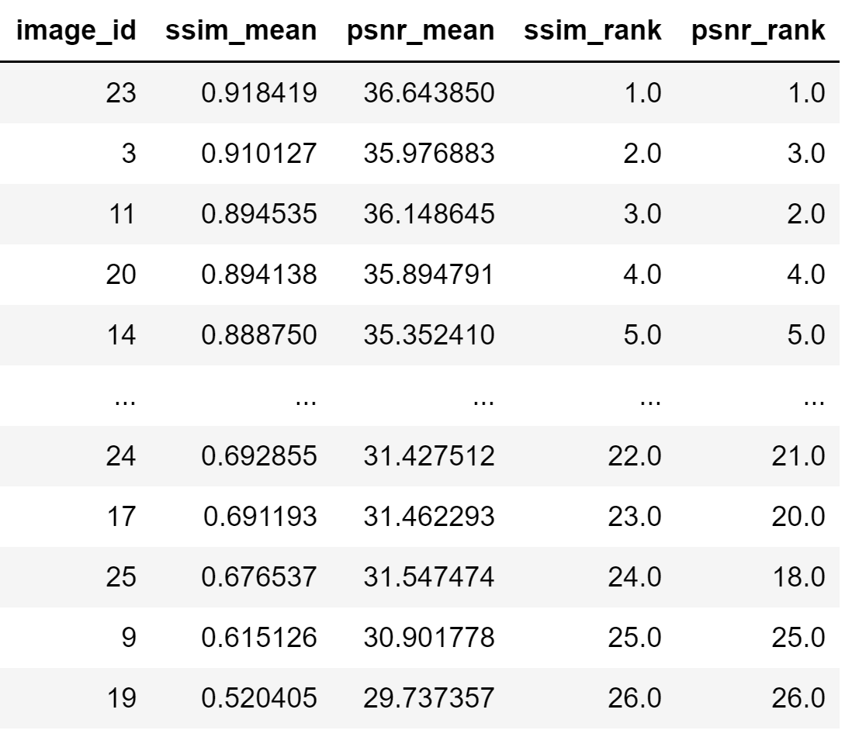
Results - Comparison

Slide 20
Conclusion & Discussion
The smaller the mask region is, the better the result of inpainting process is.
The more SSIM (similarity scores) is, the better the result image is.
For most of the cases, the better result images have higher PSRN scores.
Therefore, the good result images will mostly have the high SSIM and PSNR scores.
In general, the model is able to generate different results given a masked input image. However, those results did not really look plausible.

Slide 21
Future Works
Maybe upgrade computing environment or having a better GPU for getting the faster running time.
Continue to complete training and testing process of the artwork dataset and then do the evaluation metrics calculation.

Slide 22
References
[1] Xu, R., Guo, M., Wang, J., Li, X., Zhou, B., & Loy, C. (2020). Texture Memory-Augmented Deep Patch-Based Image Inpainting.
[2] Chuanxia Zheng, Tat-Jen Cham, and Jianfei Cai. Pluralistic image completion. In Proceedings of the IEEE Conference on Computer Vision and Pattern Recognition, pages 1438– 1447, 2019

Slide 23
Thank you for listening!
Q&A

